Slide 1
Graph Pathfinding Algorithms
Wednesday July 24: 9am – 1pm
Graph Visualizer source code review.
Implement basic graph pathfinding algorithms inside Graph Visualizer.
Spanning tree algorithm.
Breadth-First search algorithm.
Dijkstra’s algorithm.
A* algorithm.
Notes:
---- directed graph ----
A : 237,113 > B T D
B : 180,127 > P
D : 300,95 > C T
E : 362,55 > D
G : 402,287 > J
H : 174,287 > Q K
I : 236,395 > U
J : 301,306 > I R
K : 232,317 > I R
L : 78,372 > W K I
M : 136,175 > B Q
N : 155,233 > M
O : 92,222 > L N H
P : 80,81 > O M C
Q : 216,221 > N T
R : 278,250 > Q S
S : 356,241 > J F G
T : 259,171 > B R S
C : 201,47 > B A E
F : 387,177 > D X E G 1
U : 348,385 > J G
V : 30,167 > P O
W : 28,285 > V O
X : 314,148 > T D S
Y : 461,298 > U F
Z : 422,116 > E F
1 : 476,194 > Z Y
---- undirected graph ----
A : 237,113 > B C T D
B : 180,127 > P M C A T
D : 300,95 > C A T X E F
E : 362,55 > C D F Z
G : 402,287 > J U S F
H : 174,287 > O Q K
I : 236,395 > L K J U
J : 301,306 > I R U S G
K : 232,317 > L H I R
L : 78,372 > W O K I
M : 136,175 > P N B Q
N : 155,233 > O M Q
O : 92,222 > W V L P N H
P : 80,81 > V O M B C
Q : 216,221 > M N H T R
R : 278,250 > Q K T J S
S : 356,241 > T R J X F G
T : 259,171 > B Q A R D X S
C : 201,47 > P B A D E
F : 387,177 > D X S E G Z Y 1
U : 348,385 > I J G Y
V : 30,167 > W P O
W : 28,285 > V L O
X : 314,148 > T D S F
Y : 461,298 > U F 1
Z : 422,116 > E F 1
1 : 476,194 > F Z Y

Slide 2
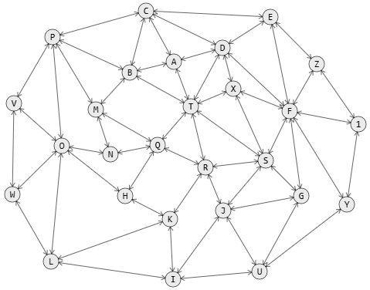
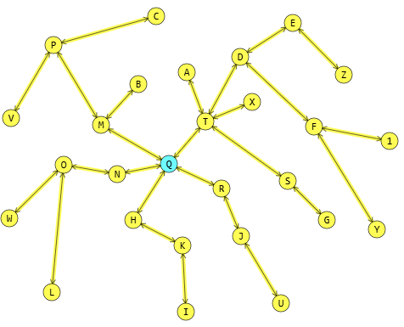
Spanning tree
Problem definition
GPT/Copilot ⟩ Describe the graph spanning tree problem in simple words.
The graph spanning tree problem involves finding a subset of edges in a graph that connects all the vertices together without any cycles, forming a tree. This tree should include all the nodes of the original graph and use the minimum possible number of edges.
A common goal is to find the Minimum Spanning Tree (MST), which is the spanning tree with the smallest total edge weight. (ref: Kruskal’s Minimum Spanning Tree (MST) algorithm)
Notes:
---- directed graph ----
A : 237,113 > B T D
B : 180,127 > P
D : 300,95 > C T
E : 362,55 > D
G : 402,287 > J
H : 174,287 > Q K
I : 236,395 > U
J : 301,306 > I R
K : 232,317 > I R
L : 78,372 > W K I
M : 136,175 > B Q
N : 155,233 > M
O : 92,222 > L N H
P : 80,81 > O M C
Q : 216,221 > N T
R : 278,250 > Q S
S : 356,241 > J F G
T : 259,171 > B R S
C : 201,47 > B A E
F : 387,177 > D X E G 1
U : 348,385 > J G
V : 30,167 > P O
W : 28,285 > V O
X : 314,148 > T D S
Y : 461,298 > U F
Z : 422,116 > E F
1 : 476,194 > Z Y
---- undirected graph ----
A : 237,113 > B C T D
B : 180,127 > P M C A T
D : 300,95 > C A T X E F
E : 362,55 > C D F Z
G : 402,287 > J U S F
H : 174,287 > O Q K
I : 236,395 > L K J U
J : 301,306 > I R U S G
K : 232,317 > L H I R
L : 78,372 > W O K I
M : 136,175 > P N B Q
N : 155,233 > O M Q
O : 92,222 > W V L P N H
P : 80,81 > V O M B C
Q : 216,221 > M N H T R
R : 278,250 > Q K T J S
S : 356,241 > T R J X F G
T : 259,171 > B Q A R D X S
C : 201,47 > P B A D E
F : 387,177 > D X S E G Z Y 1
U : 348,385 > I J G Y
V : 30,167 > W P O
W : 28,285 > V L O
X : 314,148 > T D S F
Y : 461,298 > U F 1
Z : 422,116 > E F 1
1 : 476,194 > F Z Y

Slide 3
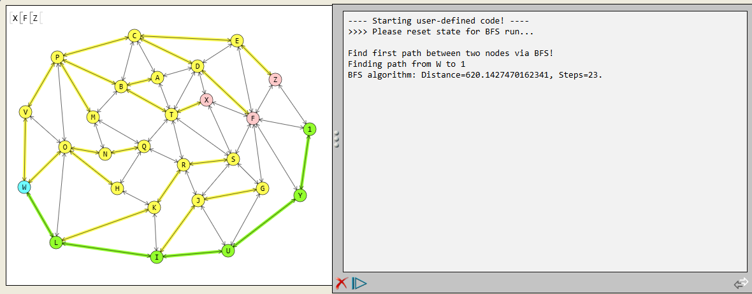
Breadth-First Search (BFS)
Simplest, but neither optimal nor performant.
GPT/Copilot ⟩ Describe the breadth first search algorithm to find the path between two nodes in a graph.
bfs(startNode, endNode)
Mark startNode as visited.
2. Initialize a queue and add startNode to it.
3. while queue is not empty do
4. Dequeue node from the front of queue.
5. if node is the endNode then
6. break.
7. endIf.
9. foreach unvisited neighbor n of node do
10. mark the n as visited.
11. link node in n as a predecessor in the path.
12. enqueue n in the queue.
13. endForeach.
14. endWhile.
15. if endNode not visited then
16. return failure; // path does not exist.
17. endIf
18. construct path by walking back predecessor links
from endNode to startNode.
Notes:
---------
A : 237,113 > B C T D
B : 180,127 > P M C A T
D : 300,95 > C A T X E F
E : 362,55 > C D F Z
G : 402,287 > J U S F
H : 174,287 > O Q K
I : 236,395 > L K J U
J : 301,306 > I R U S G
K : 232,317 > L H I R
L : 78,372 > W O K I
M : 136,175 > P N B Q
N : 155,233 > O M Q
O : 92,222 > W V L P N H
P : 80,81 > V O M B C
Q : 216,221 > M N H T R
R : 278,250 > Q K T J S
S : 356,241 > T R J X F G
T : 259,171 > B Q A R D X S
C : 201,47 > P B A D E
F : 387,177 > D X S E G Z Y 1
U : 348,385 > I J G Y
V : 30,167 > W P O
W : 28,285 > V L O
X : 314,148 > T D S F
Y : 461,298 > U F 1
Z : 422,116 > E F 1
1 : 476,194 > F Z Y

Slide 4
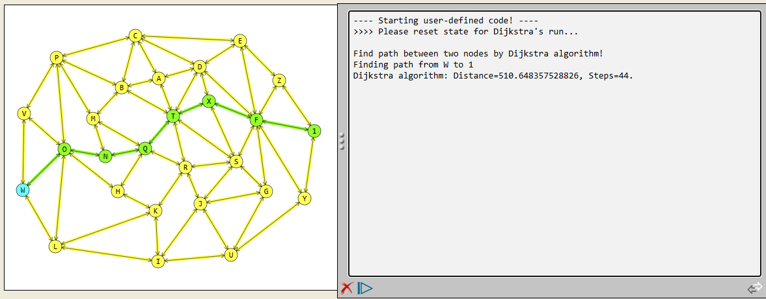
Dijkstra’s Algorithm
Best path (highest optimality) but worst performance.
GPT/Copilot ⟩ Describe the Dijkstra’s algorithm to find the path between two nodes in a graph.
dijkstras(startNode, endNode)
1. Reset distance value in all nodes to INFINITE.
2. Set startNode.distance to 0, startNode.predecessor to null.
3. Initialize a queue and add startNode to it.
4. While queue is not empty do
5. Dequeue node from the front of the queue.
6. foreach n of node.neighbors do
7. calculate dist = node.distance + distance(node, n).
8. if dist < n.dist then
9. set n.distance = dist.
10. set n.predecessor = node.
11. enqueue n at the end of queue.
12. endIf.
13. endForeach.
14. endWhile.
15. if endNode.distance is INFINITE then
16. return failure; // path does not exist
17. endIf.
18. construct path by walking back predecessor links from endNode to startNode.
Notes:
--------
A : 237,113 > B C T D
B : 180,127 > P M C A T
D : 300,95 > C A T X E F
E : 362,55 > C D F Z
G : 402,287 > J U S F
H : 174,287 > O Q K
I : 236,395 > L K J U
J : 301,306 > I R U S G
K : 232,317 > L H I R
L : 78,372 > W O K I
M : 136,175 > P N B Q
N : 155,233 > O M Q
O : 92,222 > W V L P N H
P : 80,81 > V O M B C
Q : 216,221 > M N H T R
R : 278,250 > Q K T J S
S : 356,241 > T R J X F G
T : 259,171 > B Q A R D X S
C : 201,47 > P B A D E
F : 387,177 > D X S E G Z Y 1
U : 348,385 > I J G Y
V : 30,167 > W P O
W : 28,285 > V L O
X : 314,148 > T D S F
Y : 461,298 > U F 1
Z : 422,116 > E F 1
1 : 476,194 > F Z Y

Slide 5
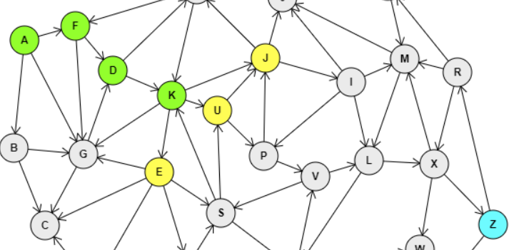

A* Algorithm
The big picture
A* is an optimization of Dijkstra: Goal is to find the optimal (shortest) path, means choosing carefully each of the next steps.
We can associate a cost function f to each of the nodes:
f(n) = g(n) + h(n)
where:
f(n) : the total estimated cost of the path through node n.
g(n) : the cost to reach n
h(n) : the estimated cost from node n to the target.
Notes:
--------
A : 237,113 > B C T D
B : 180,127 > P M C A T
D : 300,95 > C A T X E F
E : 362,55 > C D F Z
G : 402,287 > J U S F
H : 174,287 > O Q K
I : 236,395 > L K J U
J : 301,306 > I R U S G
K : 232,317 > L H I R
L : 78,372 > W O K I
M : 136,175 > P N B Q
N : 155,233 > O M Q
O : 92,222 > W V L P N H
P : 80,81 > V O M B C
Q : 216,221 > M N H T R
R : 278,250 > Q K T J S
S : 356,241 > T R J X F G
T : 259,171 > B Q A R D X S
C : 201,47 > P B A D E
F : 387,177 > D X S E G Z Y 1
U : 348,385 > I J G Y
V : 30,167 > W P O
W : 28,285 > V L O
X : 314,148 > T D S F
Y : 461,298 > U F 1
Z : 422,116 > E F 1
1 : 476,194 > F Z Y

Slide 6
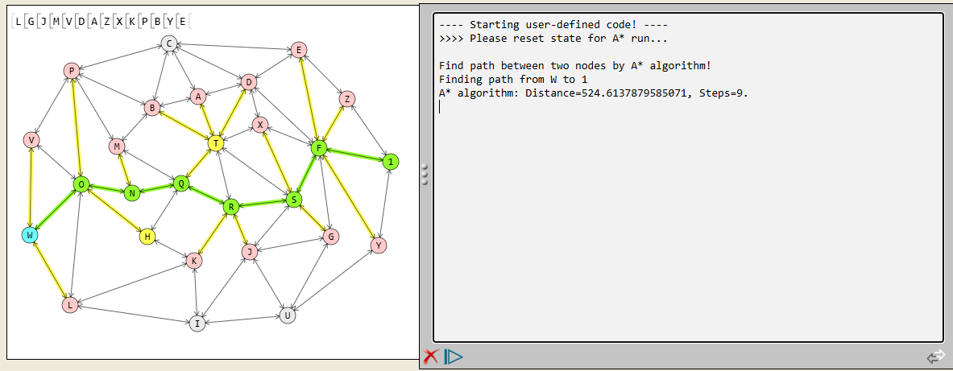
A* Algorithm
Better path (good optimality) with better performance.
GPT/Copilot ⟩ Describe the A* algorithm to find the path between two nodes in a graph.
aStar(startNode, endNode)
1. Reset cost value in all nodes to INFINITE.
Set startNode.cost to distance(startNode, endNode).
Set startNode.predecessor to null.
4. Initialize a priority queue and add startNode to it.
5. while queue is not empty do
6. Dequeue node from the front of the queue.
7. foreach n of unvisited node.neighbors do
8. set n.cost = node.cost – node.distance(node, endNode)
9. + distance(node, n) + distance(n, endNode)
10. set n.predecessor = node.
11. enqueue n in queue in priority order of cost.
12. endForeach.
13. endWhile.
14. if endNode.distance is INFINITE then
15. return failure; // path does not exist
16. endIf.
17. construct path by walking back predecessor links from endNode to startNode.
Notes:
--------
A : 237,113 > B C T D
B : 180,127 > P M C A T
D : 300,95 > C A T X E F
E : 362,55 > C D F Z
G : 402,287 > J U S F
H : 174,287 > O Q K
I : 236,395 > L K J U
J : 301,306 > I R U S G
K : 232,317 > L H I R
L : 78,372 > W O K I
M : 136,175 > P N B Q
N : 155,233 > O M Q
O : 92,222 > W V L P N H
P : 80,81 > V O M B C
Q : 216,221 > M N H T R
R : 278,250 > Q K T J S
S : 356,241 > T R J X F G
T : 259,171 > B Q A R D X S
C : 201,47 > P B A D E
F : 387,177 > D X S E G Z Y 1
U : 348,385 > I J G Y
V : 30,167 > W P O
W : 28,285 > V L O
X : 314,148 > T D S F
Y : 461,298 > U F 1
Z : 422,116 > E F 1
1 : 476,194 > F Z Y

